Slide 1

MRI-Based Biomarkers for Early Detection and Classification of Alzheimer Disease Using Machine Learning Project Category: RESEARCH
Guide Name Student Name & Registration Number
Dr. M. Karpagam V.R.Rishendra (RA2111026010221)
Rangineni Yukthamukhi (RA2111026010262)

Slide 2
Abstract
Alzheimer's Disease (AD) is a progressive neurodegenerative disorder and the leading cause of dementia, primarily affecting older adults.
Magnetic Resonance Imaging (MRI) has emerged as a valuable tool for identifying structural brain changes associated with AD, such as localized and generalized tissue shrinkage.
Leveraging these biomarkers, machine learning (ML) techniques can play a transformative role in predicting disease progression and aiding clinical decision-making.
This study aims to develop a robust ML model for early detection and classification of Alzheimer's disease using longitudinal MRI data.
This approach not only enhances diagnostic precision but also supports clinicians in optimizing therapeutic strategies and improving patient outcomes.
The integration of MRI and ML represents a significant step toward advancing early diagnosis and management of Alzheimer's disease.

Slide 3
Introduction
Alzheimer's disease is a progressive neurodegenerative disorder and the most prevalent cause of dementia, primarily affecting older adults.
Its early symptoms, such as selective memory impairment, make timely detection and intervention critical.
Role of MRI in AD Diagnosis: Magnetic Resonance Imaging (MRI) serves as a vital tool for evaluating patients with suspected Alzheimer's.
Characteristic findings include localized and generalized brain tissue shrinkage, which may provide essential insights into disease progression and therapeutic planning.
Significance of Machine Learning in AD Research:Machine learning offers the potential to accurately predict a patient's progression from mild cognitive impairment to full-blown dementia.
By leveraging MRI biomarkers, ML models can enhance diagnostic precision and guide clinicians in early detection and management of AD.

Slide 4
Problem Statement
Alzheimer's Disease (AD): A progressive neurodegenerative disorder and the leading cause of dementia, AD primarily affects older adults. While treatments can ease symptoms, no cure exists.
Early Signs: Memory impairment is the earliest clinical symptom, often missed until the disease advances. Early detection is vital for timely intervention.
MRI in Diagnosis: MRI scans reveal brain tissue shrinkage, providing valuable insights into AD progression and potential diagnostic biomarkers.
Machine Learning Potential: Machine learning can analyze MRI features to predict the progression from mild cognitive impairment to dementia, aiding early diagnosis and treatment.

Slide 5
Objectives
Develop a machine learning model that leverages MRI-based biomarkers for early detection of Alzheimer's disease.
Accurately classify patients into categories such as Nondemented, Demented.
Analyze MRI data to predict the progression from mild cognitive impairment to dementia.
Enhance diagnostic precision to aid clinicians in early intervention and treatment planning.
Improve patient outcomes by enabling timely and accurate detection of Alzheimer's disease.

Slide 6
Datasets
Context: The Open Access Series of Imaging Studies (OASIS) is a project aimed at making MRI data sets of the brain freely available to the scientific community. By compiling and freely distributing MRI data sets, we hope to facilitate future discoveries in basic and clinical neuroscience. OASIS is made available by the Washington University Alzheimer’s Disease Research Center
https://www.kaggle.com/datasets/jboysen/mri-and-alzheimers?select=oasis_longitudinal.csv
We will be using the longitudinal MRI data.
The dataset consists of a longitudinal MRI data of 150 subjects aged 60 to 96.
Each subject was scanned at least once.
Everyone is right-handed.
72 of the subjects were grouped as 'Nondemented' throughout the study.
64 of the subjects were grouped as 'Demented' at the time of their initial visits and remained so throughout the study.
14 subjects were grouped as 'Nondemented' at the time of their initial visit and were subsequently characterized as 'Demented' at a later visit. These fall under the 'Converted' category.

Slide 7
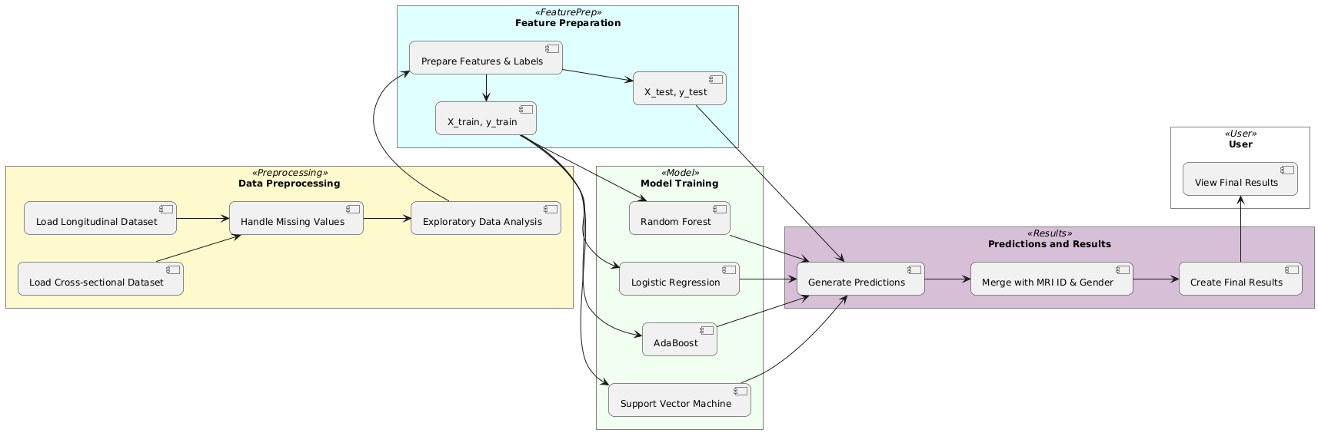
System Architecture

Slide 8
System Architecture Flow
1. Data Input
The system begins with data acquisition from two datasets.
One dataset contains longitudinal MRI scans, capturing brain changes over time.
The second dataset is a cross-sectional dataset, providing a single snapshot of different individuals.
These datasets are essential for analyzing patterns and predicting cognitive decline.
2. Data Preprocessing
The first step involves checking data consistency to ensure all necessary columns are present.
Missing values are handled to avoid biases or gaps in training—unknown values are imputed.
Exploratory Data Analysis (EDA) is performed to understand the structure and distribution of the data.
3. Feature and Label Preparation
Data is divided into features (X) and labels (y) to create training and test datasets.
The training set helps the model learn patterns, while the test set evaluates performance.
The labels indicate whether a subject is demented, non-demented, or converted over time

Slide 9
4. Key Data Components
The longitudinal dataset provides temporal information, allowing models to detect progression trends.
The cross-sectional dataset is used to validate findings and compare different subject groups.
The extracted features (e.g., brain volume, cognitive scores, gender, and age) are critical for classification.
The dataset is now ready for machine learning model training.
5. Model Training
Various machine learning models are trained to predict cognitive decline.
Random Forest helps with handling complex relationships in data.
AdaBoost improves weak classifiers by focusing on errors.
Support Vector Machine (SVM) helps define decision boundaries for classification.
K-Nearest Neighbors (KNN) classifies subjects based on similarities to existing data points.
Logistic Regression is used for baseline classification performance.
Each model learns from the training data to identify early indicators of Alzheimer's Disease.

Slide 10
6. Prediction
The trained models predict outcomes based on unseen test data.
Probabilities are assigned to each class, determining the likelihood of cognitive impairment.
Predictions are converted into meaningful labels, such as "Demented" or "Non-Demented".
7. Result Generation
The final step involves merging predictions with patient details (e.g., MRI ID, gender, age).
A Results DataFrame is created, displaying actual vs. predicted classifications.
The first few results are displayed for quick verification of model performance.
8. User Interaction
The user can review predictions, accuracy, and classification reports.
Further analysis can be done to improve model performance and refine predictions.
The system helps detect early cognitive decline, contributing to better Alzheimer’s diagnosis and intervention strategies.

Slide 11
Features
Age – A crucial factor in Alzheimer's progression, as the risk increases with age.
Mini-Mental State Examination (MMSE) Score – Measures cognitive impairment and helps classify dementia stages.
Clinical Dementia Rating (CDR) – Provides an assessment of dementia severity.
Education Level (Educ) – Higher education levels may correlate with cognitive reserve and affect dementia diagnosis.
Socioeconomic Status (SES) – Can impact access to healthcare and early diagnosis.
Brain Volume Measurements – MRI-derived features like hippocampal volume, which are key biomarkers in AD detection.
Gender – Some studies suggest differences in AD prevalence and progression between males and females.

Slide 12
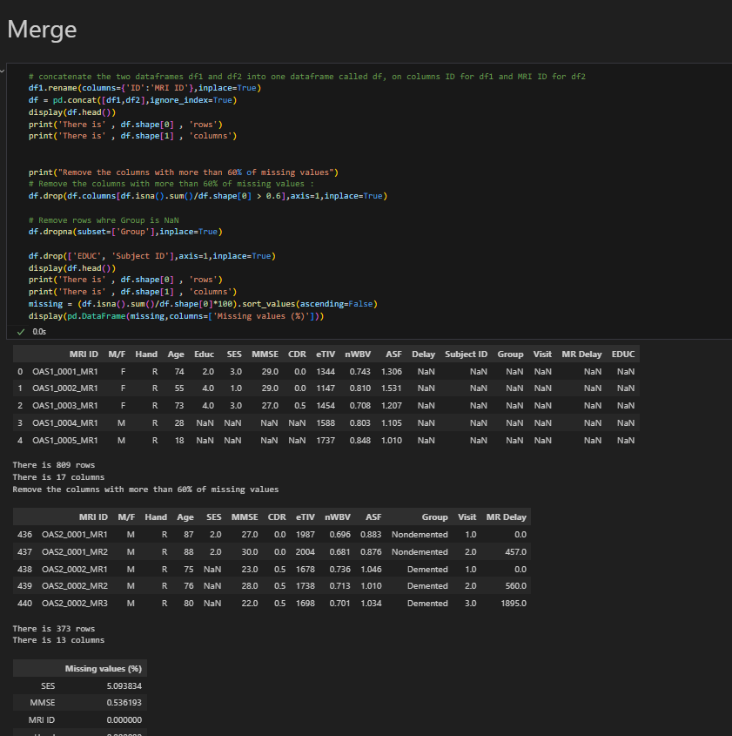
Implementation

Slide 13
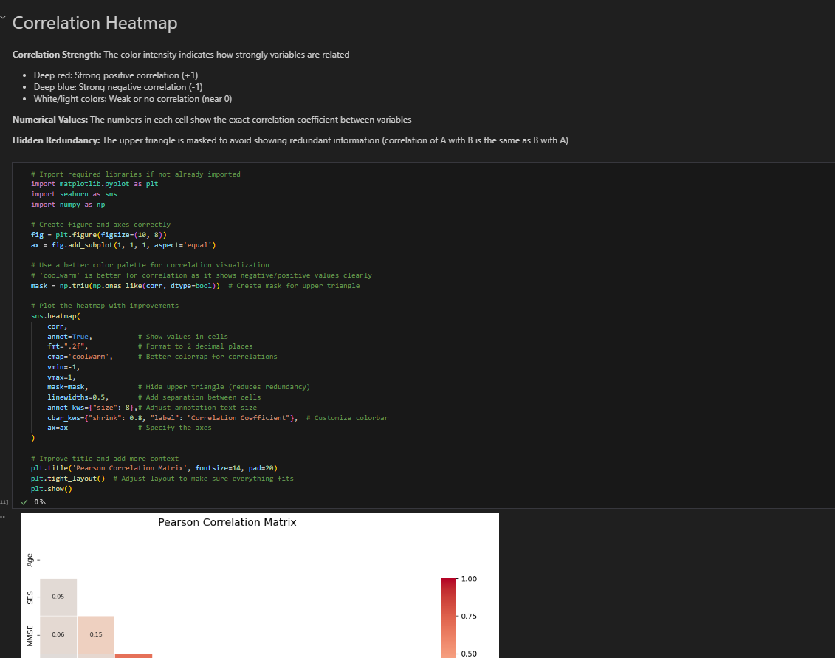

Slide 14
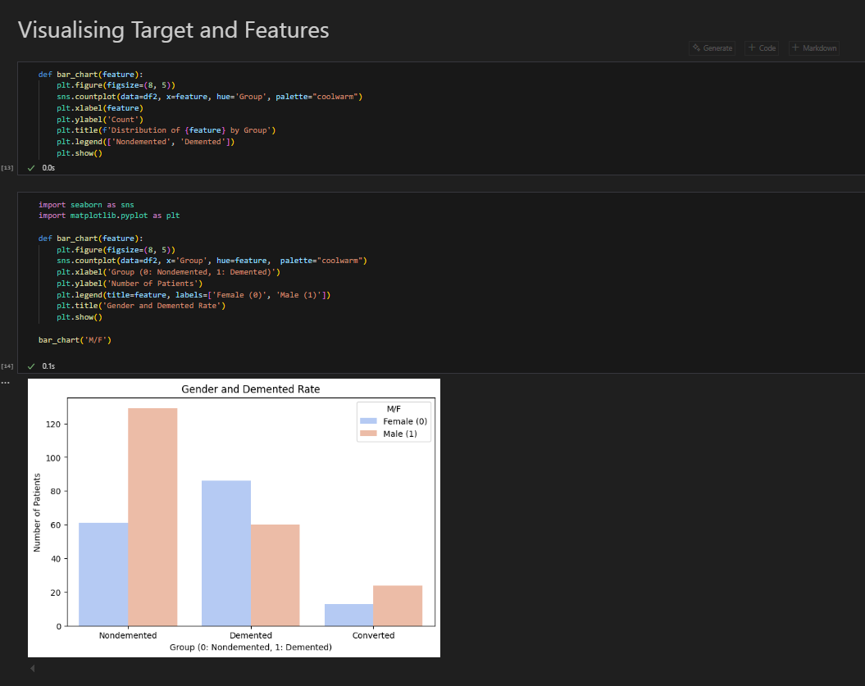

Slide 15
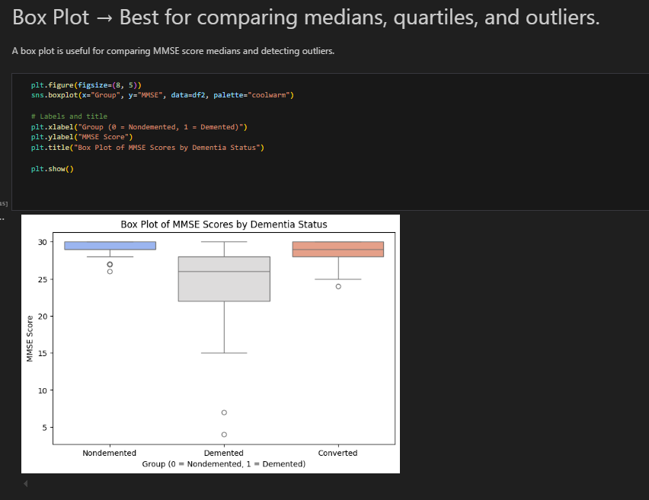

Slide 16
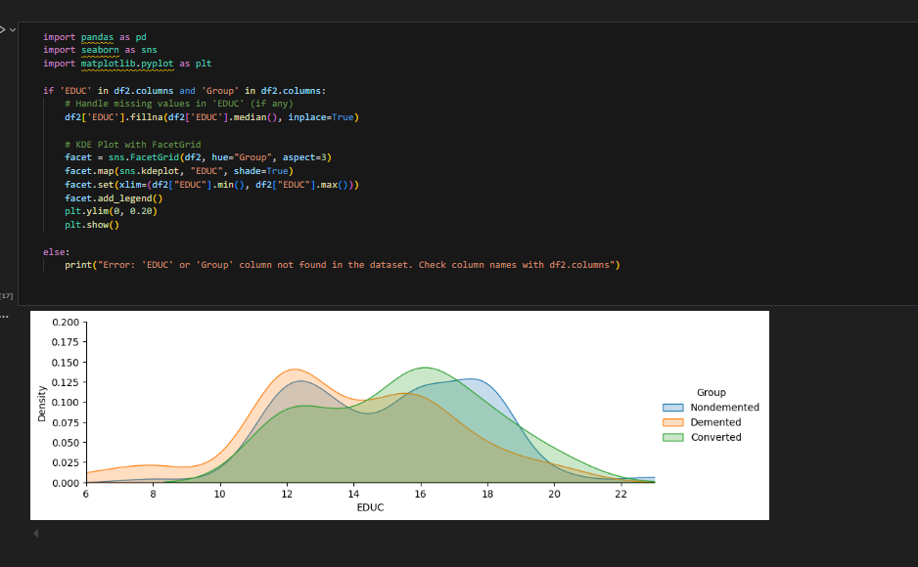

Slide 17
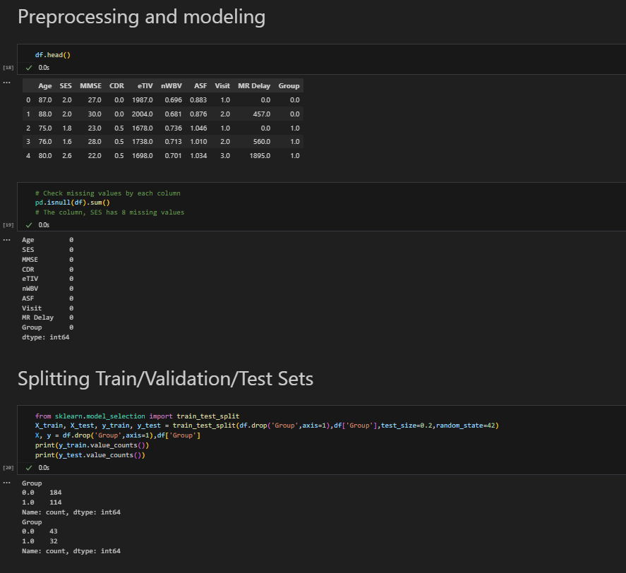

Slide 18
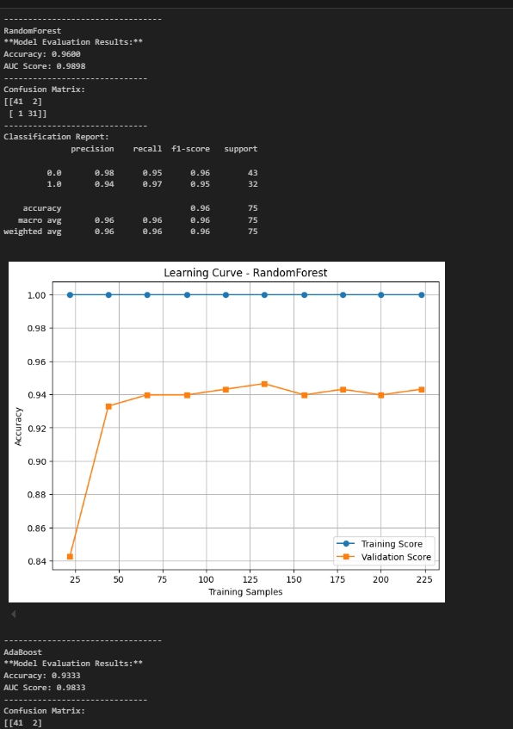
Result

Slide 19
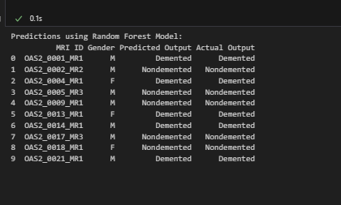
Result

Slide 20
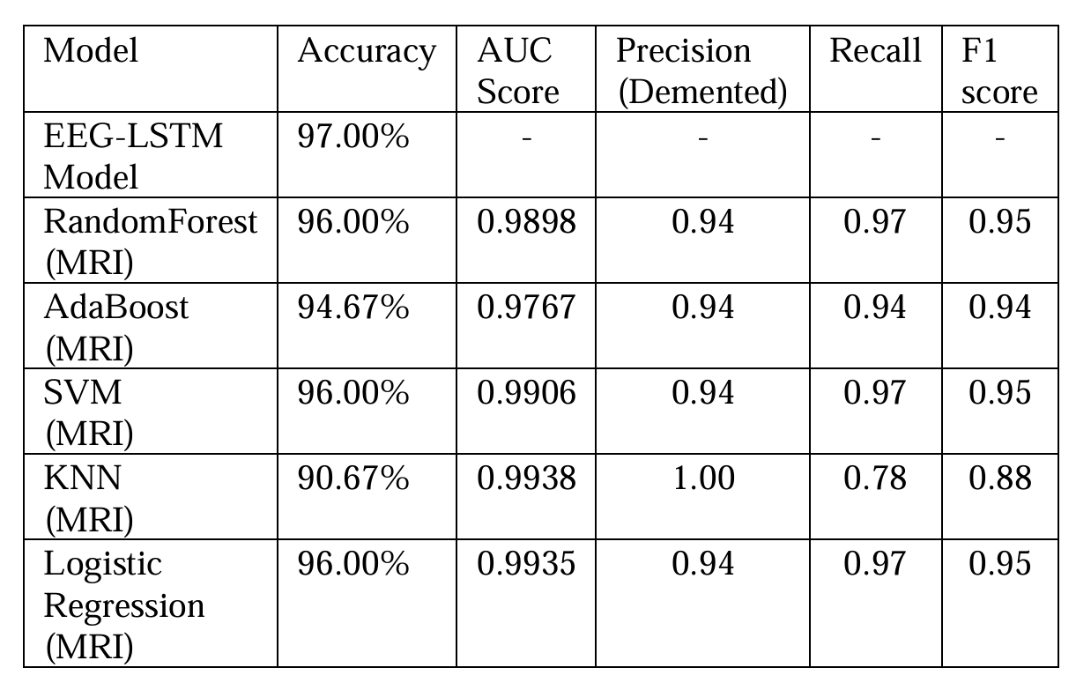
Result

Slide 21
Limitations
Dataset Limitation: The limited size of the dataset restricts the model's ability to capture complex patterns and effectively classify differences between groups (e.g., Nondemented, Demented).
Feature Classification: While the nature of each feature is understood, the ranges of test values across different groups are not well-differentiated, which may impact the model's ability to detect meaningful patterns.
Random Forest Performance: The Random Forest model predicts higher values than other models, indicating potential for better prediction accuracy if more attention is given to data cleaning and feature analysis.
SVM Recall Performance: The SVM model achieves a perfect recall score of 1.0, but this may not translate well to other datasets, suggesting the model's performance could drop when applied to new data.
Overfitting Risk: The high performance of SVM on the current dataset raises concerns about overfitting, where the model may struggle to generalize to different datasets or real-world scenarios.

Slide 22
Literature Survey
https://docs.google.com/spreadsheets/d/1ePDLt6_2aRJLiBC5knvTCYL0_gOVTgQX/edit?usp=sharing&ouid=103152651925061077615&rtpof=true&sd=true
We chose MRI over EEG due to its superior spatial resolution, which is essential for detecting structural brain changes in Alzheimer's. MRI data is also more stable and less prone to noise, ensuring higher reliability. Additionally, MRI captures rich anatomical and volumetric biomarkers that are more robust for distinguishing normal aging from Alzheimer's. Uniquely, our model incorporates MMSE scores and education level, leveraging cognitive and demographic metrics to enhance its ability to differentiate between healthy individuals and those with Alzheimer's.

Slide 23
References
https://www.mdpi.com/1212822
https://www.thelancet.com/journals/lanhl/article/PIIS2666-7568(21)00166-5/fulltext
https://www.aph.gov.au/About_Parliament/Parliamentary_Departments/Parliamentary_Library/FlagPost/2020/October/Causes_of_death
https://www.eurekaselect.com/article/93206

